Slide 1
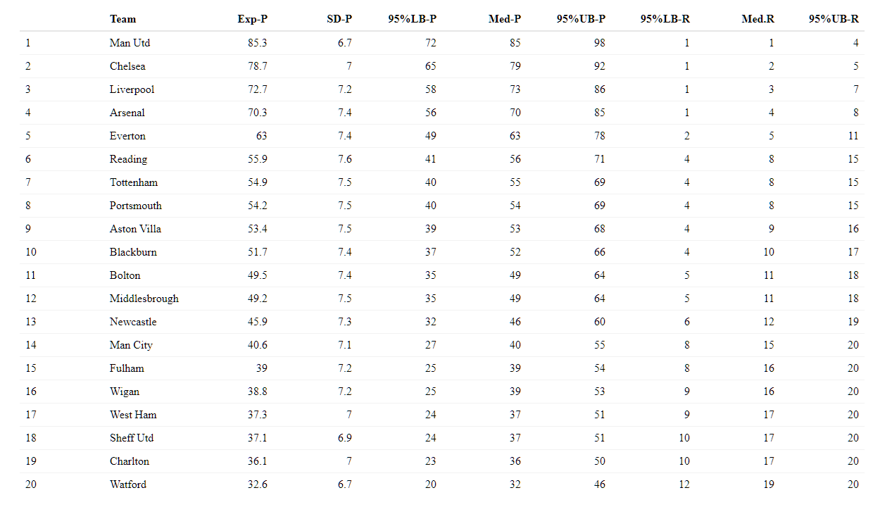
95% CI
Lower Bound
(Points)
95% CI
Upper Bound
(Points)
95% CI
Lower Bound
(Ranking)
95% CI
Upper Bound
(Rankings)
Stand. Deviation
(Points)
Expected
Points
Median
Points
Median
Ranking

